Slide 1
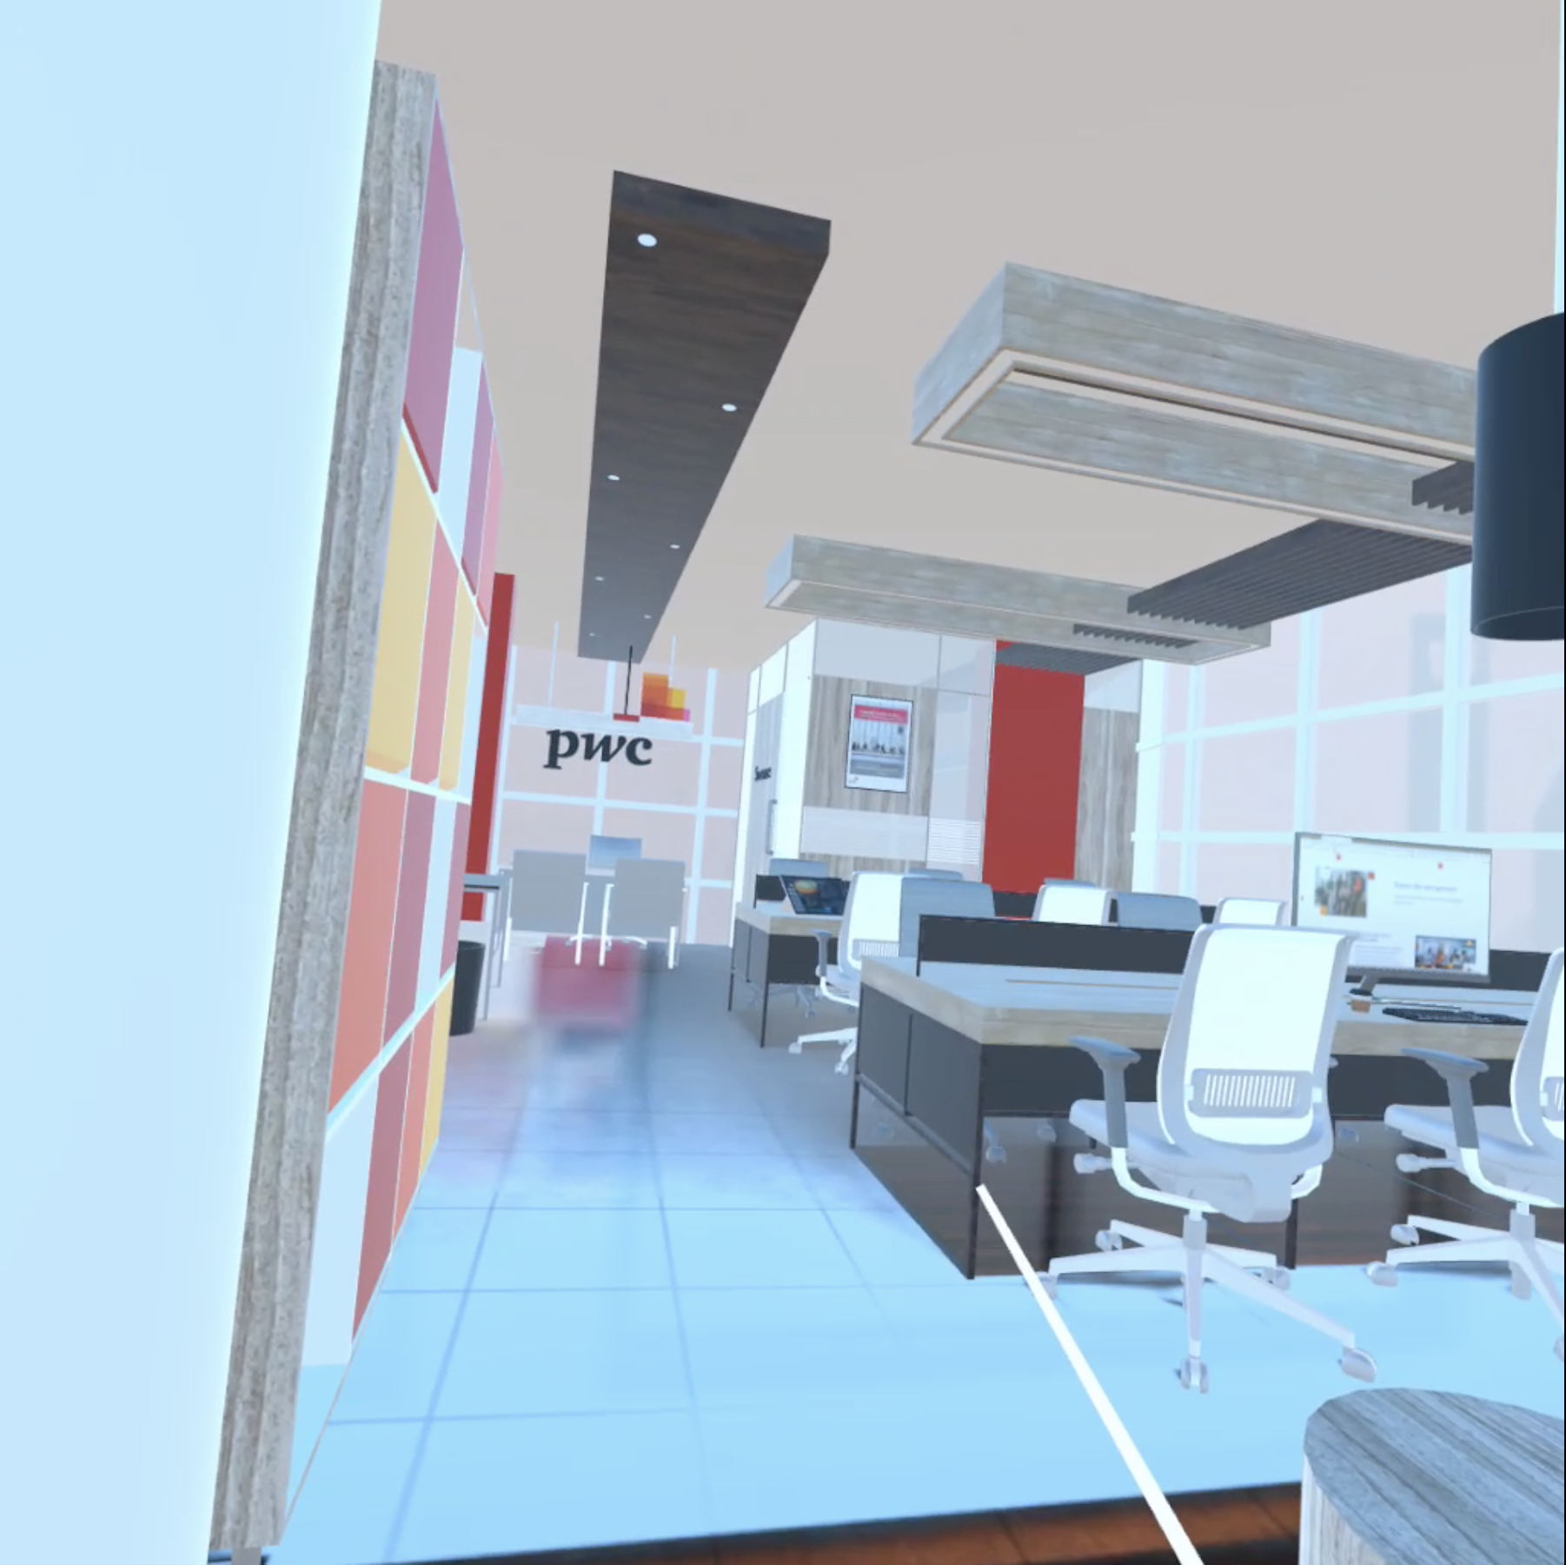


WELCOME TO PROJECT HEX
TO BE ADDED
TO BE ADDED
Import Flow Diagram​
View Existing Flow Diagram​
Other Option A
Other Option B

Slide 2
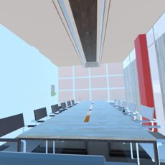

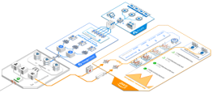
Overall Chart. --> Region ( network, AKS pod ) --> Service
Overall Chart
Text number data refreshed
Line color change / Component color change
Region
Zoom in / Zoom out
2. Dashboard on wall
Service
Pick up / Rotate
Xx %, in/out net

Slide 3
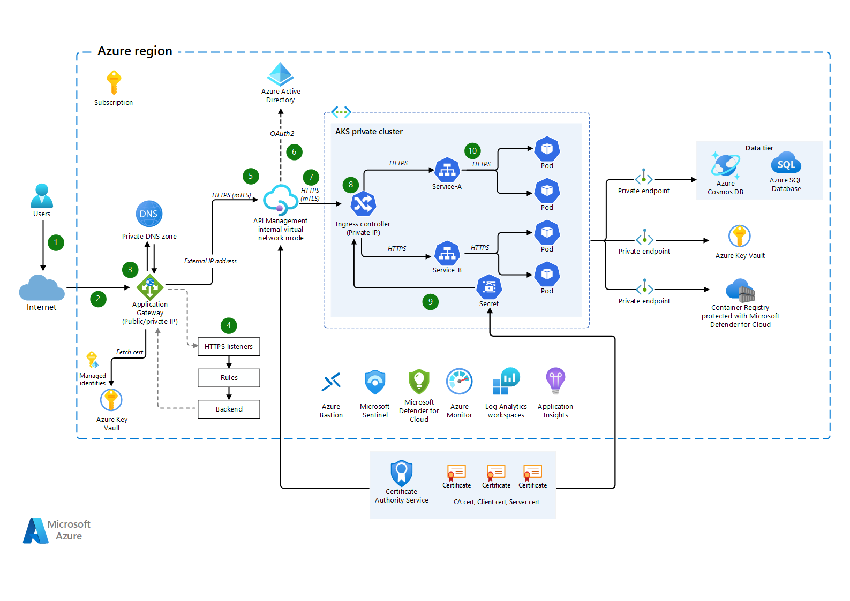
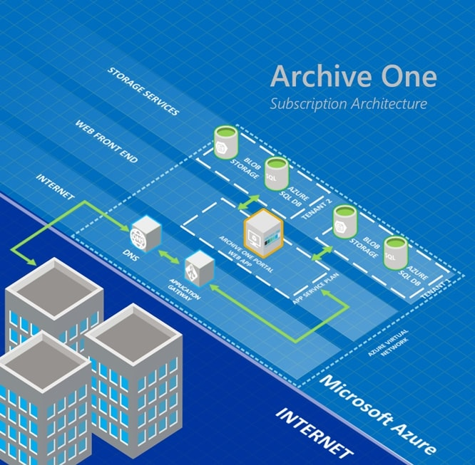

Slide 4
Appendix

Slide 5
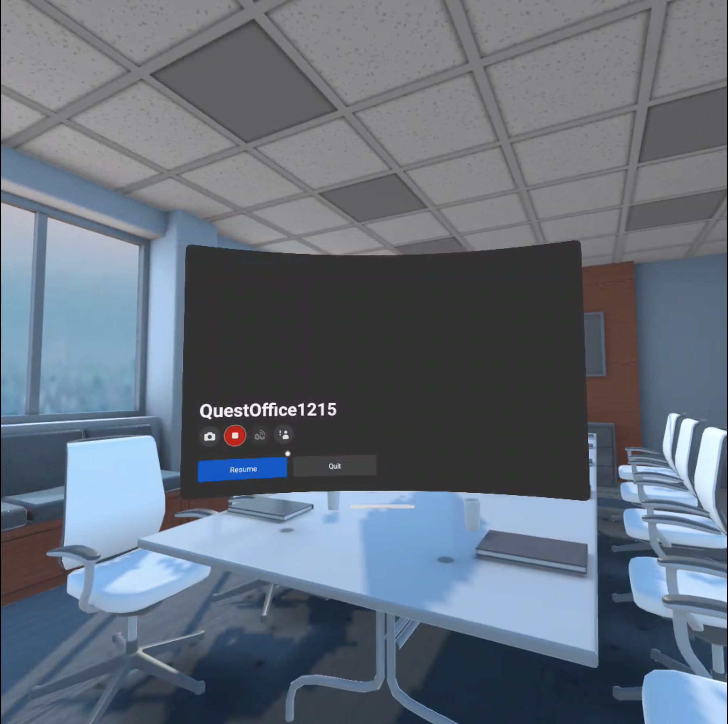



Step 1. Entrance Menu (Landing page)
Font style, Size

Slide 6



Slide 7

WELCOME TO PROJECT HEX
TO BE ADDED
TO BE ADDED
Import Flow Diagram​
View Existing Flow Diagram​
Other Option A
Other Option B

Slide 9
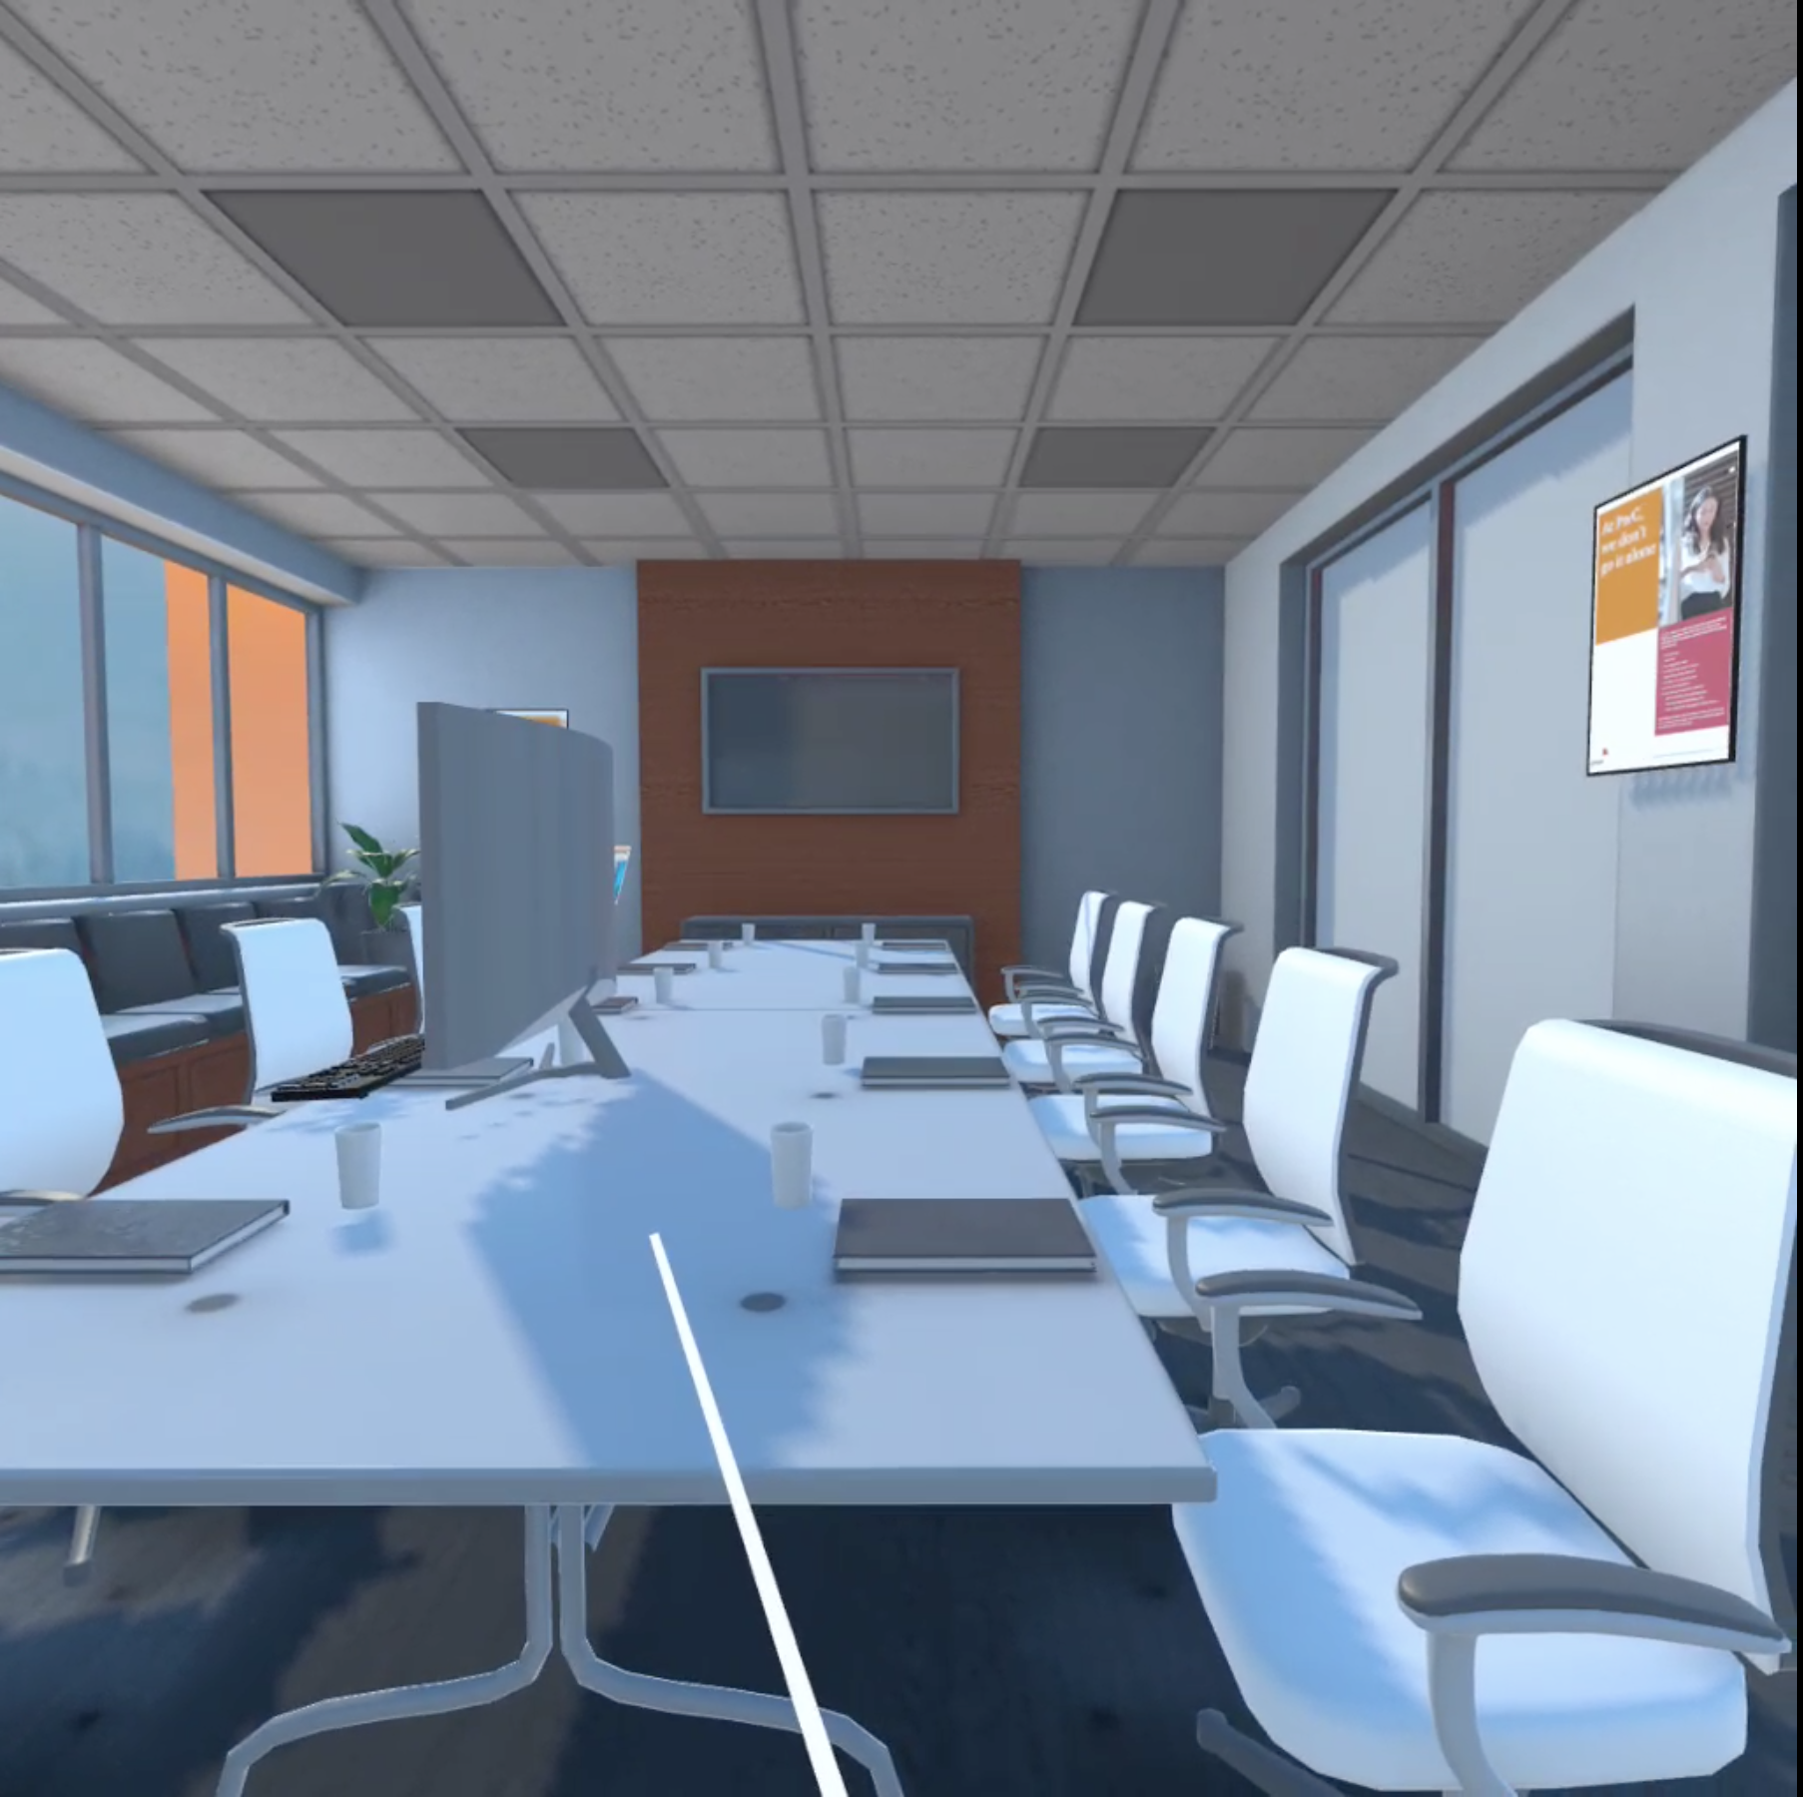
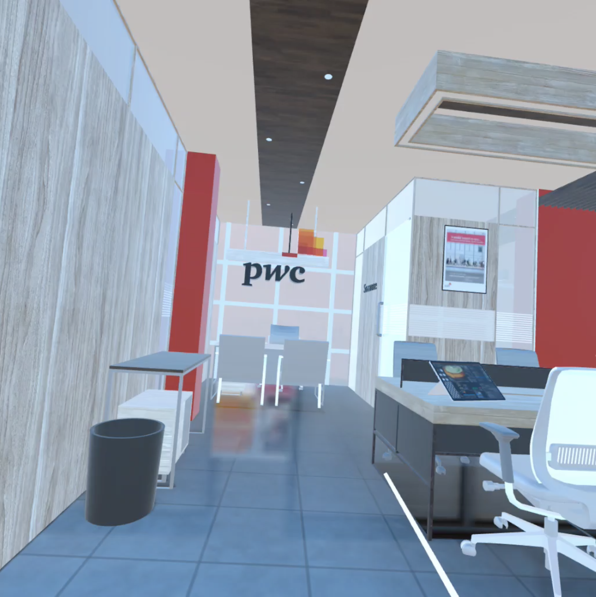
Step 2.

Slide 10
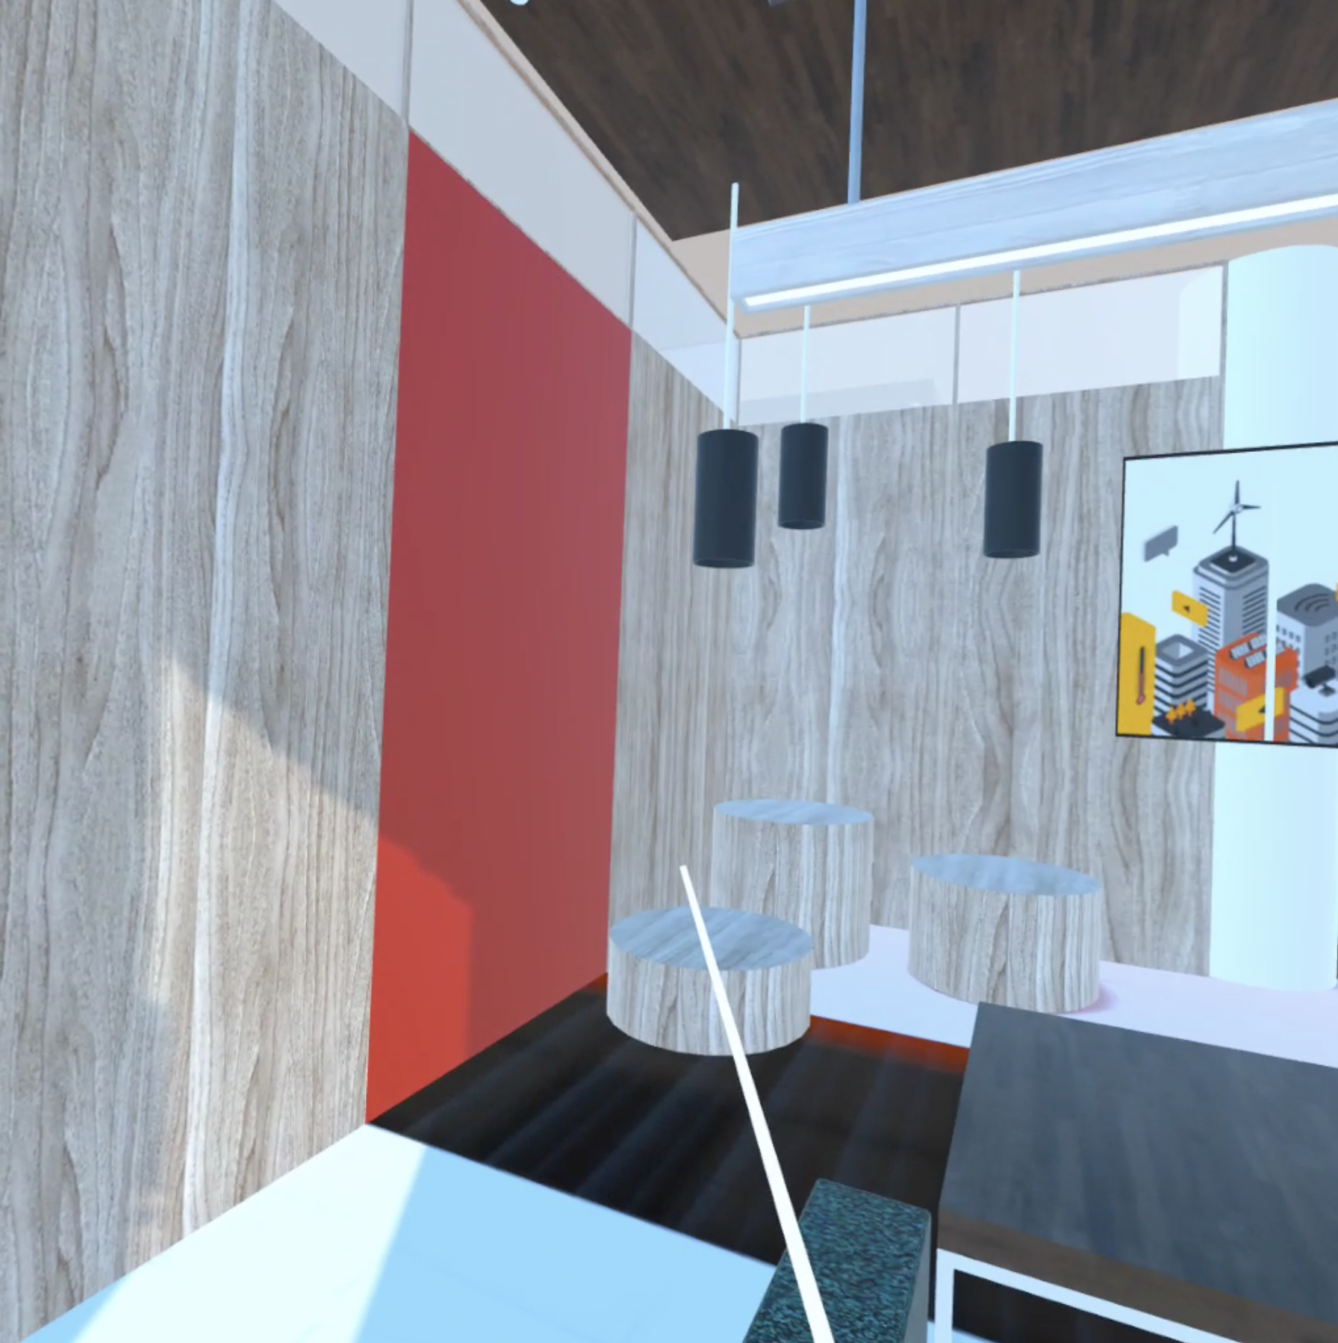


Slide 11


Slide 12
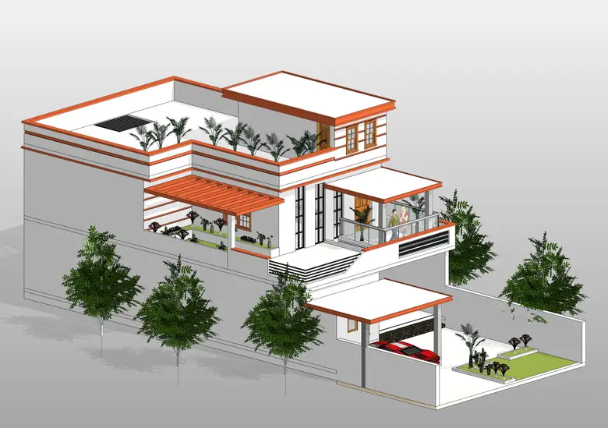

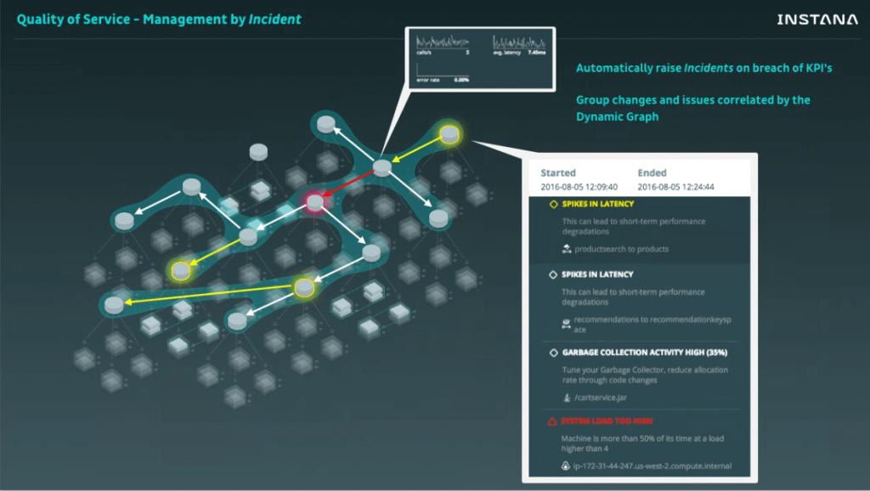
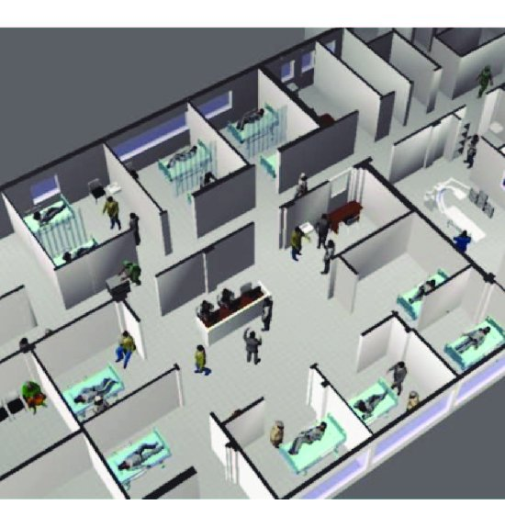

Slide 13
Step 1. Entrance Menu (Landing page)
Exit Hex
Welcome To Project Hex
Solution and Data Architecture in AR / VR​
View Existing Flow Diagram
Import Flow Diagram

